Slide 1





Team Core Four Presents
Asansol Engineering College
“IoT Based Patient Health Monitoring System using ESP32 Web Server”
By,
Uddipta Das (10800320040)
Prabhat Kr. Paswan (10800320041)
Ranjan Kumar (10800320044)
Prasenjit Mondal (10800320048)
Suraj Chowhan (10800320058)

Slide 2

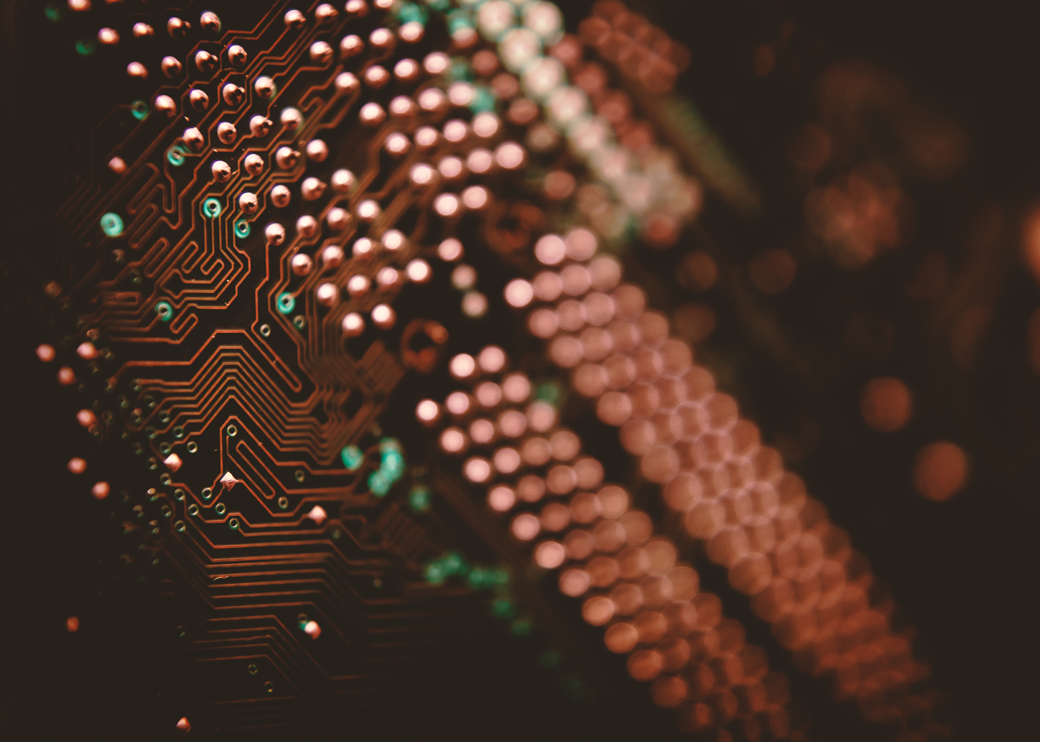
CONTETS
TABLE OF CONTENTS
OVERVIEW
BILL OF MATERIALS
CONCLUSION

Slide 3
Table of Contents
S.N. | COMPONENTS NAME | QUANTITY
1. | ESP32 Board | 1
2. | MAX30100 Pulse Oximeter Sensor | 1
3. | DS18B20 Sensor | 1
4. | DHT11 Sensor | 1
5. | Resistor 4.7K | 1
6. | Connecting Wires | 16
7. | Breadboard | 1

Slide 4
BILL OF MATERIALS
Following are the components required for making this project. All the components can be purchased from Amazon. The components purchased link is given below.
S.N. | COMPONENTS NAME | QUANTITY | PRICE
1. | ESP32 Board | 1 | 340
2. | MAX30100 Pulse Oximeter Sensor | 1 | 180
3. | DS18B20 Sensor | 1 | 160
4. | DHT11 Sensor | 1 | 150
5. | Resistor 4.7K | 1 | 10
6. | Connecting Wires | 16 | 64
7. | Breadboard | 1 | 90

Slide 5
OvervieW
With tons of new healthcare technology start-ups, IoT is rapidly revolutionizing the healthcare industry. Keeping track of the health status of your patient at home is a difficult task because of the busy schedules and our daily life work. Specially old age patients should be periodically monitored. So we propose an innovative system that automated this task with ease. Our device puts forward a smart patient health tracking system using Web Server so that the Patient health parameters like Heart Rate and Blood Oxygen level along with body temperature can be monitored.
So in this project, we will learn how to make IoT Based Patient Health Monitoring System Project. We will use the MAX30100/102 Pulse Oximeter sensor to measure the Heart Rate/Pulse(BPM) as well as the Blood Oxygen Level(SpO2). We will use a DS18B20 Temperature Sensor to measure the temperature of the body. Similarly Patient needs to be placed in a room with a certain temperature and humidity level so that he doesn’t feel uncomfortable. In order to do that we need to monitor the room temperature and humidity as well. So we will be using DHT11 Humidity & Temperature Sensor.
Here is the earlier basic version of this project using Pulse Sensor & LM35 Temperature Sensor.

Slide 6
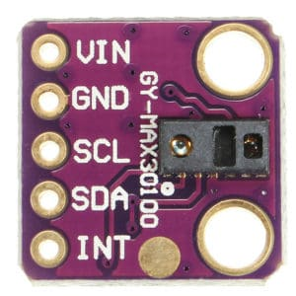
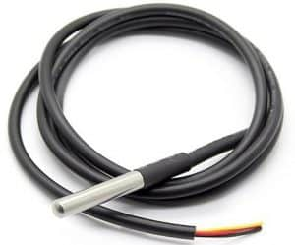
This sensor is integrated pulse oximetry and heart-rate monitor sensor solution. It combines two LED’s, a photodetector, optimized optics, and low-noise analog signal processing to detect pulse and heart-rate signals. It operates from 1.8V and 3.3V power supplies and can be powered down through software with negligible standby current, permitting the power supply to remain connected at all times.
MAX30100 Pulse
Oximeter Sensor
This is a pre-wired and waterproofed version of the DS18B20 sensor. Handy for when you need to measure something far away, or in wet conditions. The Sensor can measure the temperature between -55 to 125°C (-67°F to +257°F). The cable is jacketed in PVC.
DS18B20 Temperature
Sensor

Slide 7
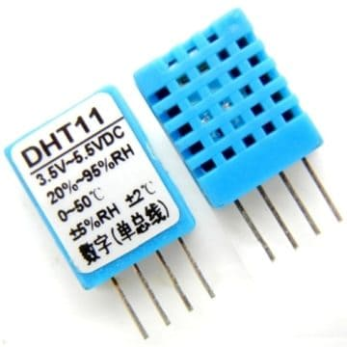
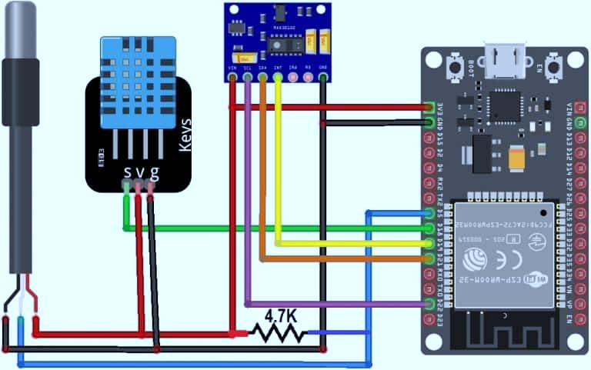
The DHT11 is a basic, ultra low-cost digital temperature and humidity sensor. It uses a capacitive humidity sensor and a thermistor to measure the surrounding air and spits out a digital signal on the data pin (no analog input pins needed).
DHT11 Humidity & Temperature Sensor
The designing of IoT Based Patient Health Monitoring on ESP32 Web Server. So, the circuit diagram for interfacing MAX30100, DHT11 & DS18B20 with ESP32 is here

Slide 8
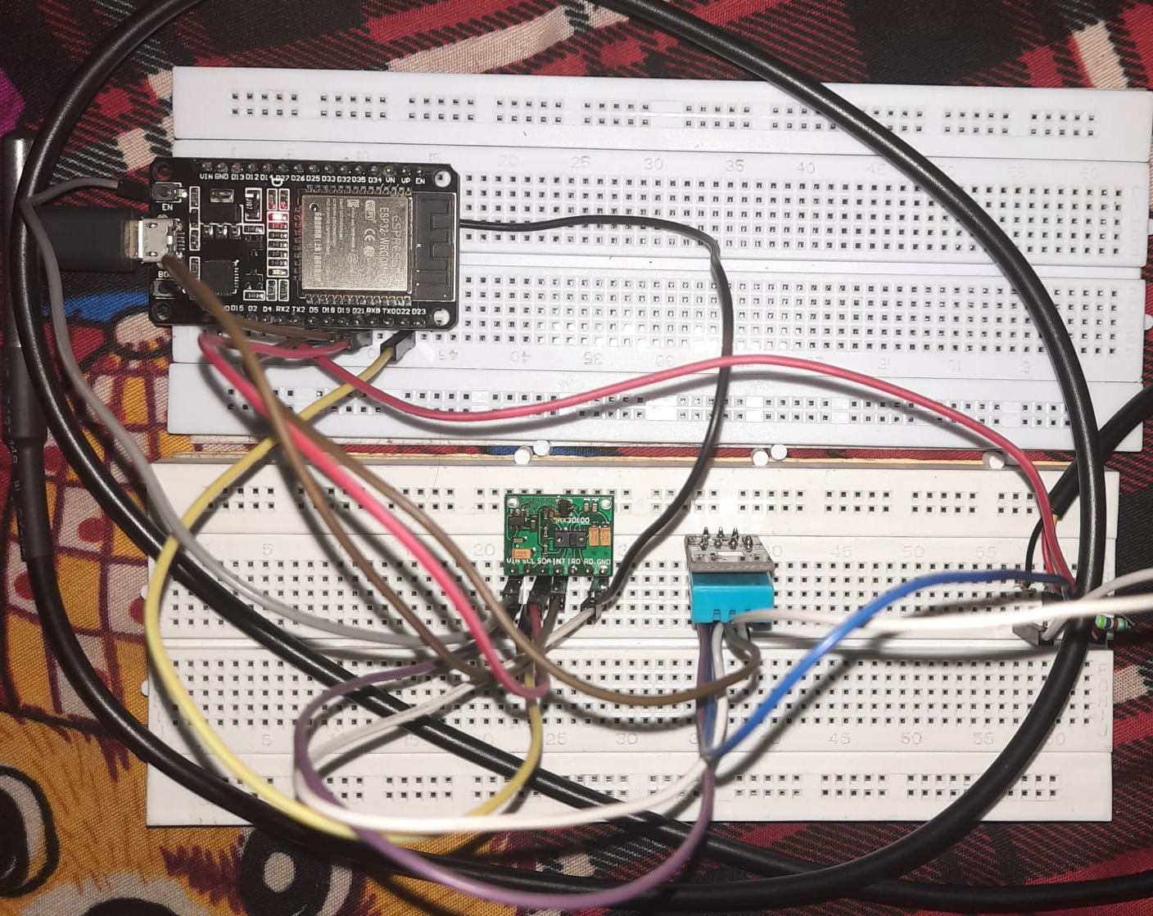
Distribution
Here I assembled the circuit on a breadboard. So I designed a PCB for it using Easy EDA PCB Designing tool.

Slide 9
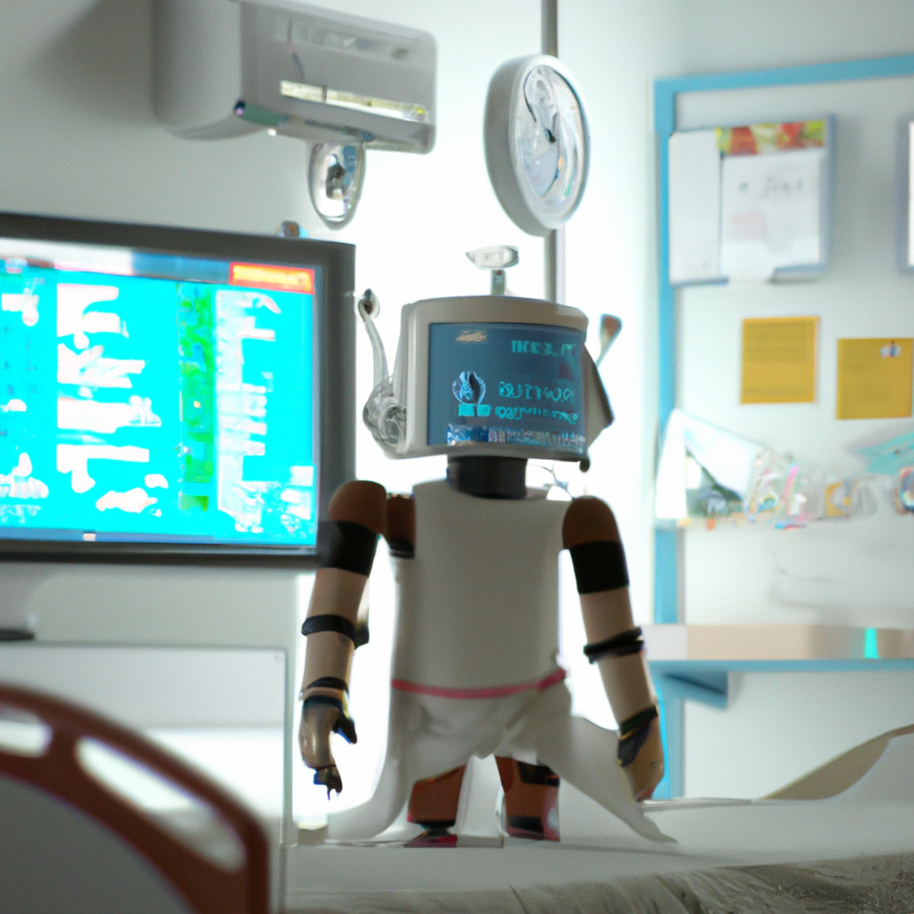
ADVANTAGES OF IOT BASED PATIENT HEALTH MONITORING ON ESP32
The ESP32 is a low-cost and low-power system on a chip (SoC) with Wi-Fi and Bluetooth capabilities. This makes it an ideal choice for building Internet of Things (IoT) applications, such as patient health monitoring systems.
The ESP32 can also be used to create secure and reliable patient health monitoring systems. The data collected can be used to track a patient's health over time, allowing for better diagnosis and treatment.

Slide 10
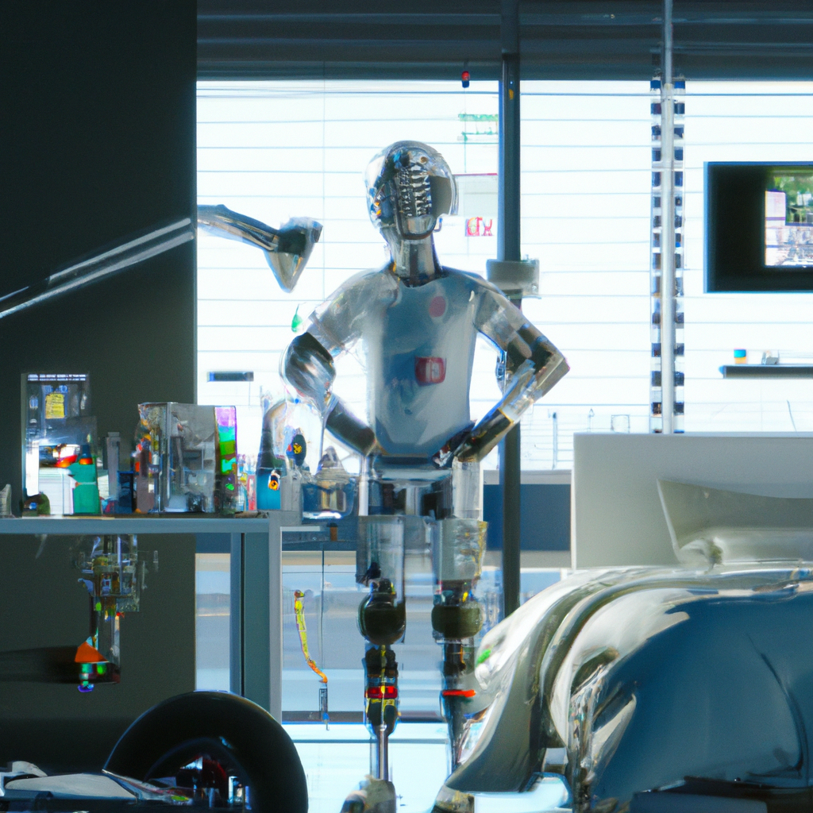
APPLICATIONS OF IOT BASED PATIENT HEALTH MONITORING ON ESP32
The ESP32 can be used to create patient health monitoring systems for hospitals and other healthcare facilities. The data collected can be used to track a patient's health over time and provide better care.
The ESP32 can also be used to create remote patient health monitoring systems. Sensors can be used to collect data from patients in remote locations, which can then be sent to a cloud platform for storage and analysis.

Slide 11

Distribution
CONCLUSION
The ESP32 is a low-cost and low-power system on a chip (SoC) with Wi-Fi and Bluetooth capabilities. It is an ideal choice for building Internet of Things (IoT) applications, such as patient health monitoring systems.
The ESP32 can be used to create secure and reliable patient health monitoring systems. The data collected can be used to track a patient's health over time, allowing for better diagnosis and treatment.

Slide 12
THANK YOU
FROM TEAM CORE FOUR😊

